Slide 1
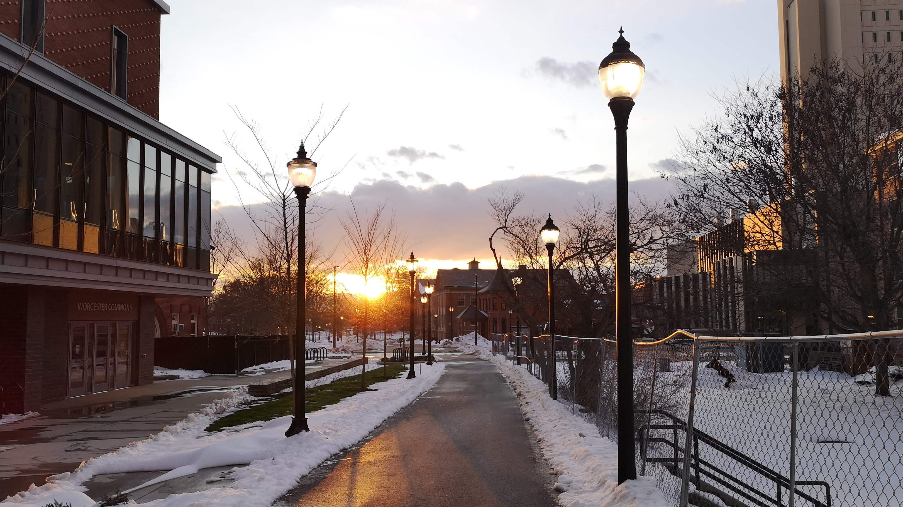
Astronomy 100/1 Lab Sunset Photo Project
[Spring/Fall] 202[x]
Yvonne Ban
UMass Amherst
Amherst, Massachusetts
22 Dec 2020

Slide 2
Important Policies
Please log in to Moodle and carefully review then respond to the Photo Policy Acknowledgement. You won’t be able to get credit for other activities until you do so!

Slide 3
Project: Admiring the Sunset for Credit
You can do either the sunset OR sunrise, as long as you are consistent for all pictures.
Pick a spot that:
You can get to again regularly later in the semester
Has a clear view of the horizon
The sunset(/sunrise) will shift along the horizon over time, so keep that in mind. In the spring(/autumn), the sunset with shift north(/south), which is to the right(/left), and vice versa for the sunrise.
Has features on the horizon that allow you to pinpoint how the sunset moves over time
An ocean view isn’t useful unless there are fixed features you can use, like islands.
You will precisely document so others can replicate your pictures.

Slide 4
Project: Admiring the Sunset for Credit
Take a picture:
With your camera zoomed out to zoom factor 1x
Within about 5 degrees of the horizon
In which the Sun’s azimuth can be clearly discerned
Don’t delete failed pictures!
Take pictures that precisely document the position you took your picture from.

Slide 5
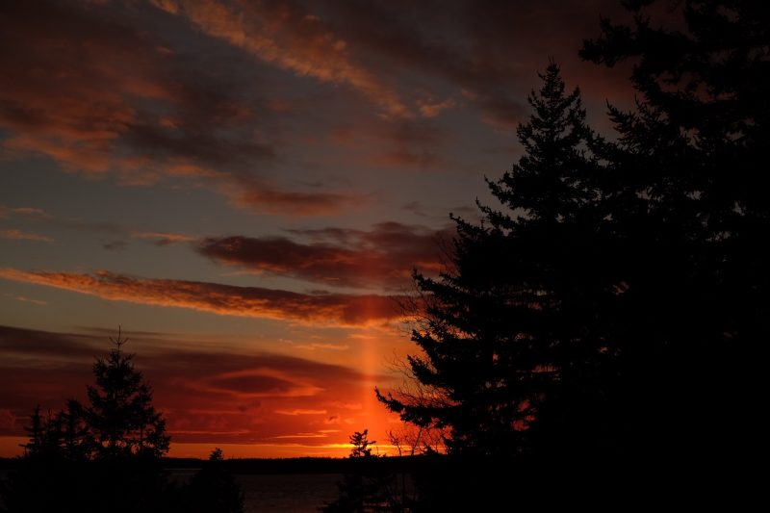
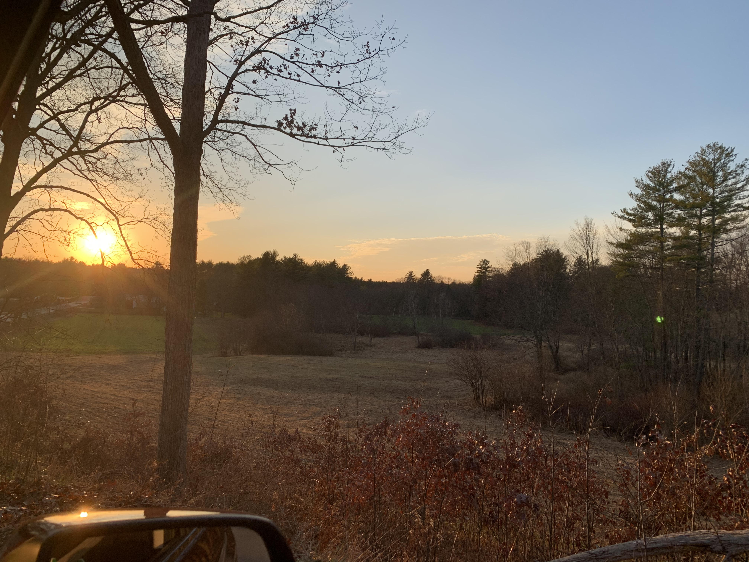
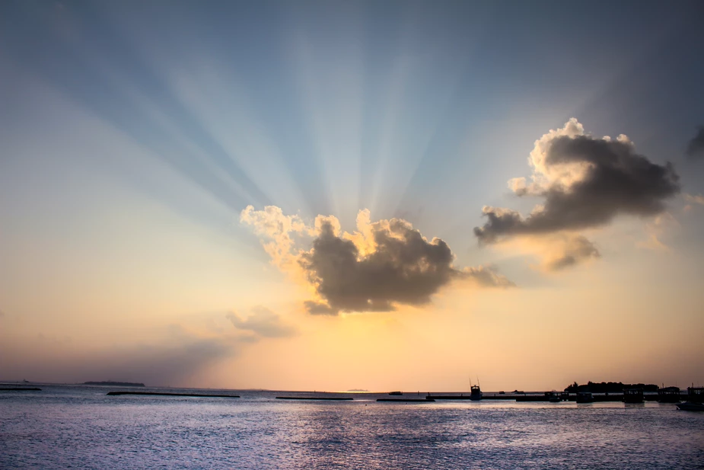
Workable Pictures for Sunset Project
A little after sunset, but “sun pillar” lets you determine Sun’s azimuth.
The Sun is behind a cloud, but “sun beams” point back to its position.

Slide 6
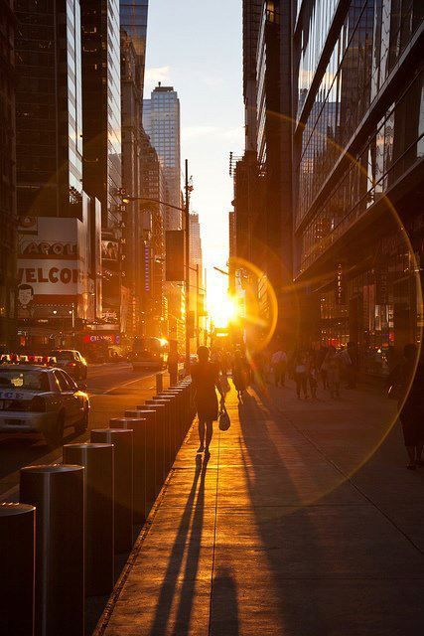
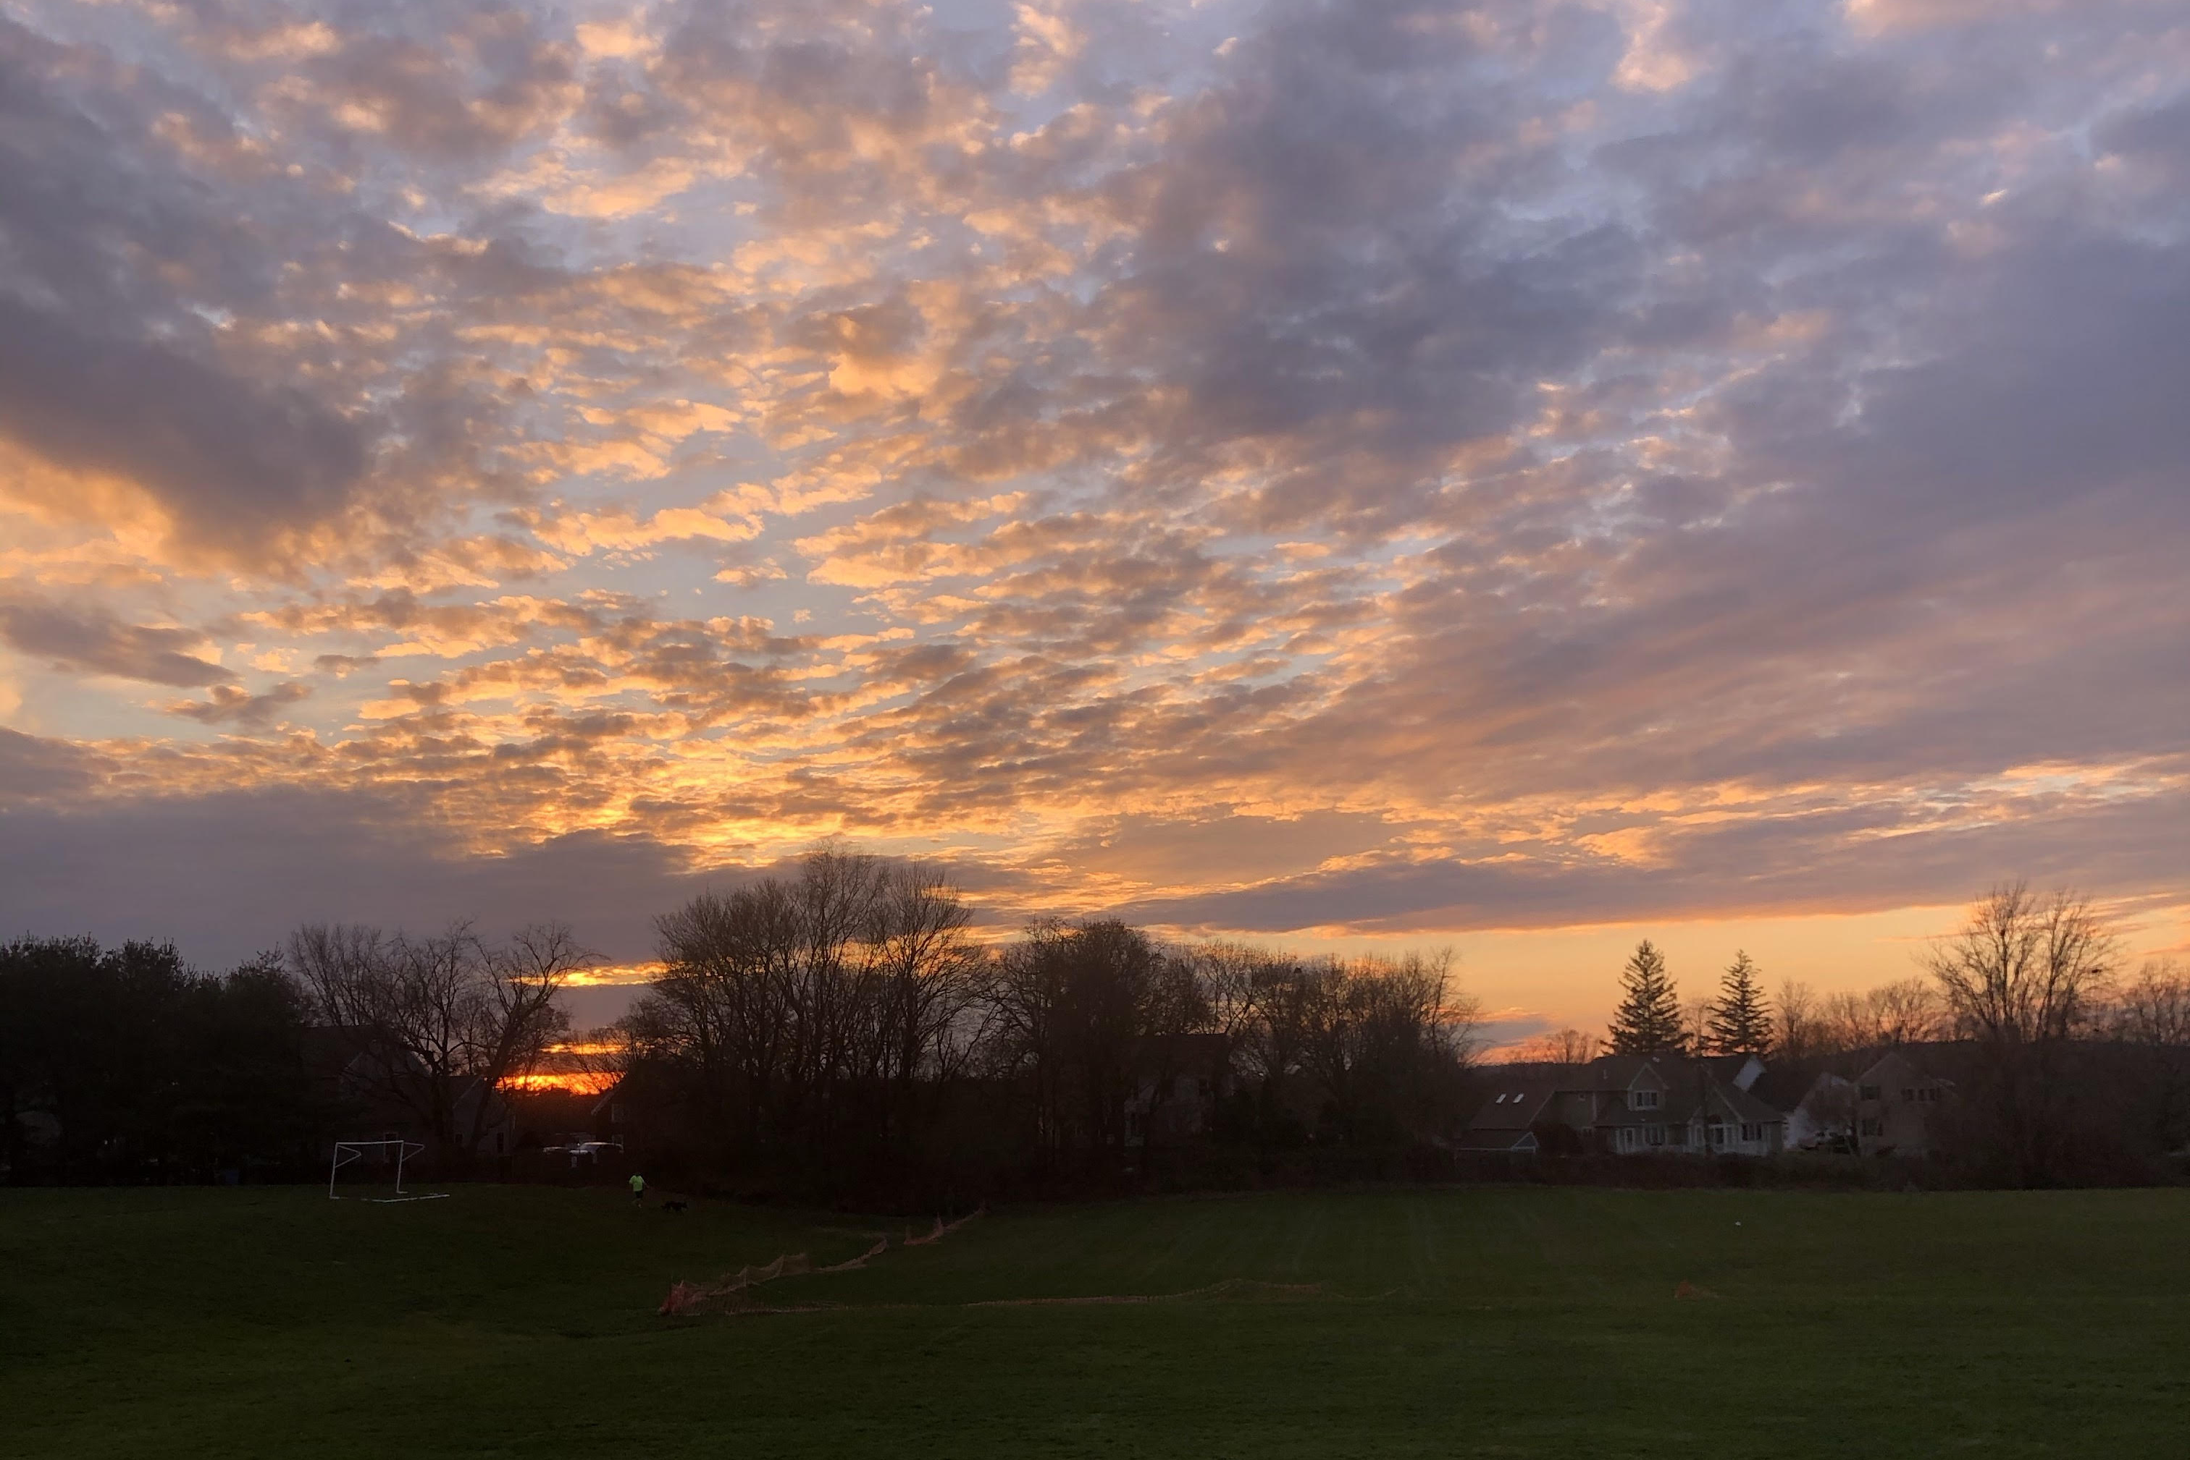
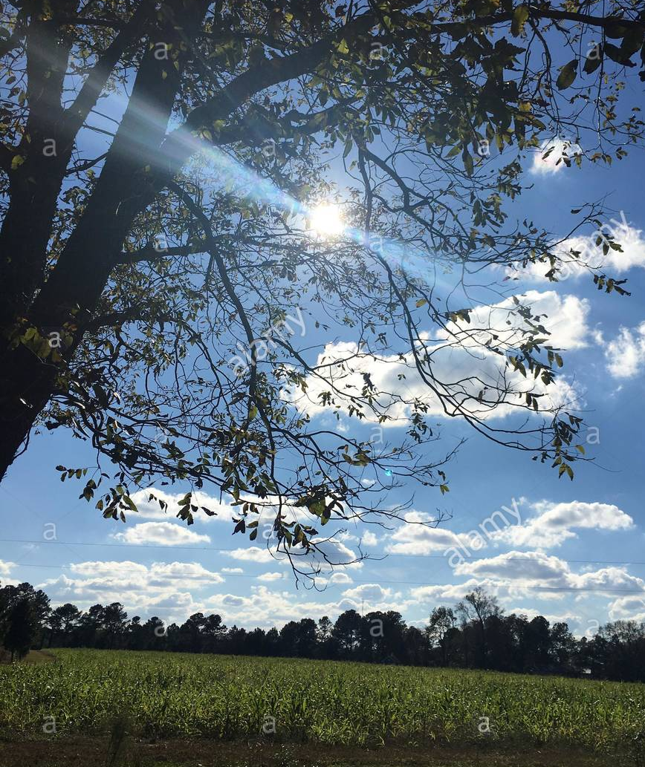
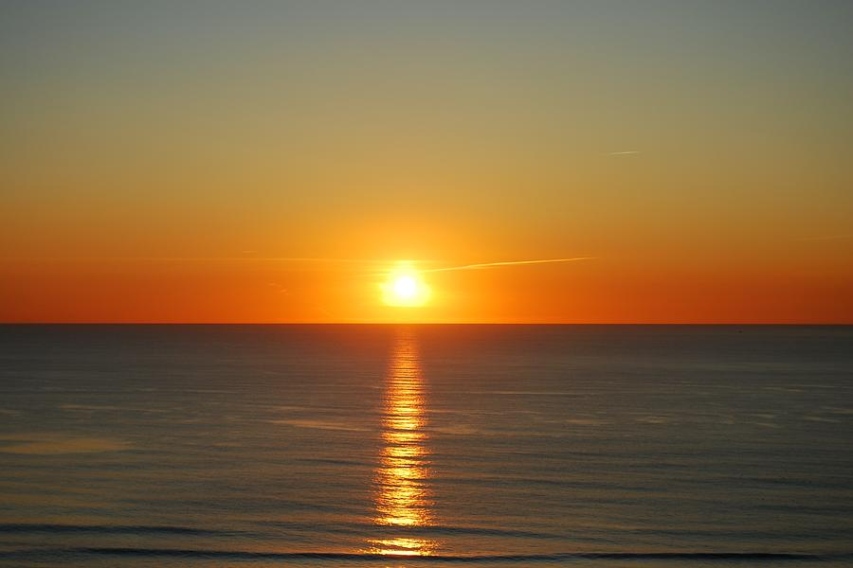
Pretty Pictures with Problems!
Can’t tell Sun’s azimuth
Not enough horizon to view Sun on later dates
No features on horizon
Not near enough horizon

Slide 7
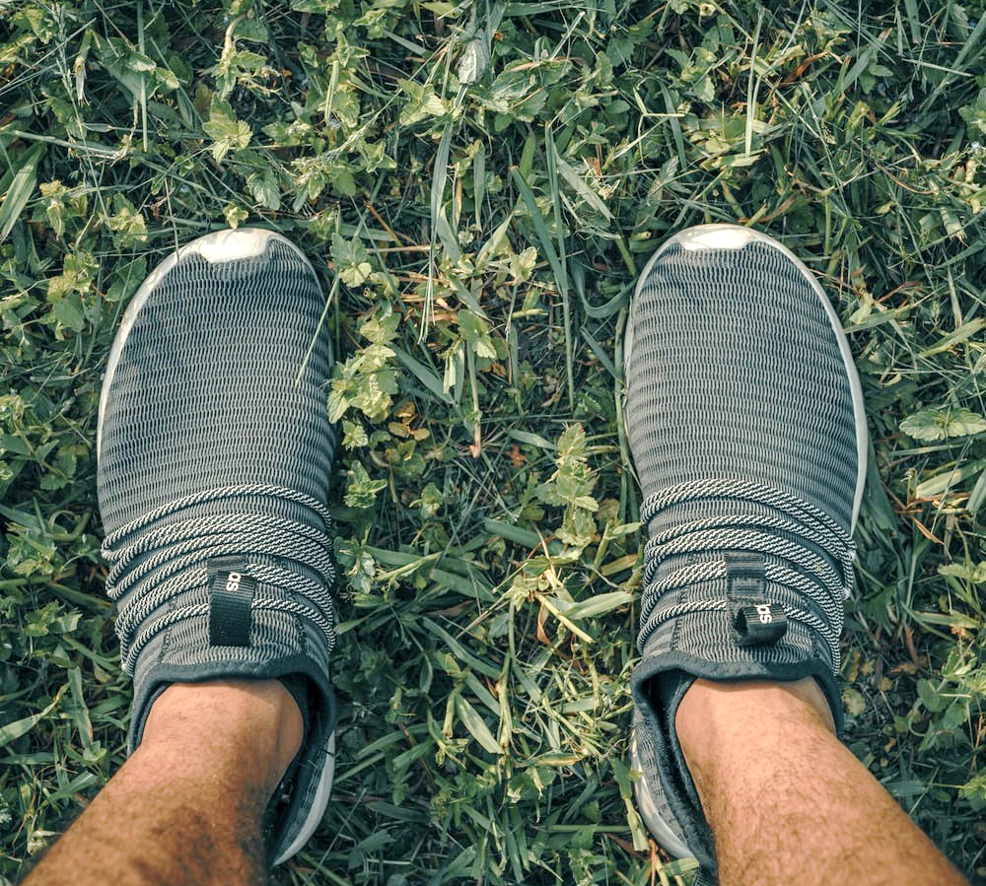
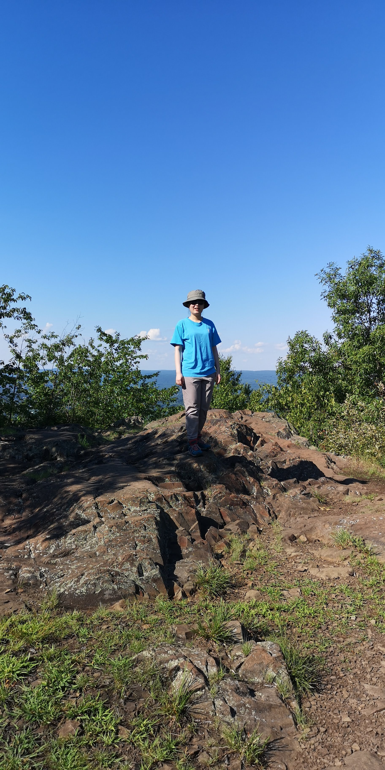

Documenting your location…
You will probably need to show a picture of a map along with photos that show where you were standing clearly.
Someone else should be able to return to the exact same spot to take a follow-up picture.

Slide 8
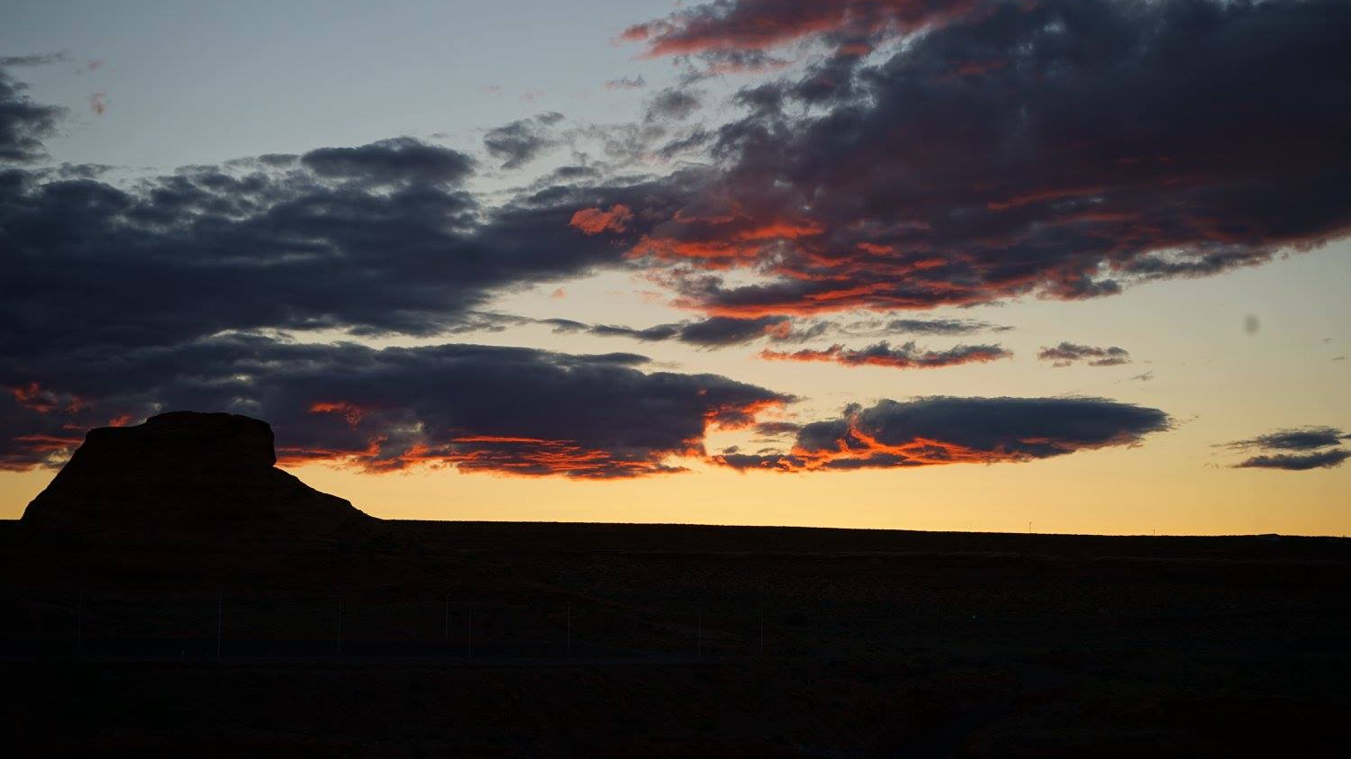
Due dates: 1 Mar – camera calibration grids 11 Mar – 1st sunset picture 19 Apr – project submission including 2 more sunset pictures
Yvonne Ban
Arizona
20 May 2017

Slide 9
Sunset Project: Part 2
You should have gotten your first sunset/sunrise photo.
Bonus point for submitting by Mar 11!
Get a second photo at least a week after the first, from the same location.
Get a third photo at least 4 weeks after the first, also from the same location.
1st photo
2nd photo
3rd photo
1 week
4 weeks
time

Slide 10
Sunset project: Part 2
You need 2 follow-up sunset pictures after your first one.
Your 2nd photo should be at least 1 week after your first.
Your 3rd photo should be at least 4 weeks after your first AND at least 1 week after your second.
You will also need to submit Stellarium screenshots of the Sun’s position at the same time and location of all your photos, and record the azimuth and elevation data.
After you turn in your pictures you will fill out a final report on Moodle:
about your photos
comparing the Sun’s position in your photos
predicting where the Sun will set on 21 June (the summer solstice) on a picture.
If you are unable to get good sunset pictures, make sure to upload your attempts.

Slide 11
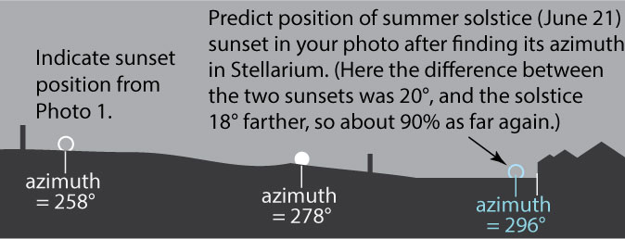
Sunset Project – Final Report
Submit a marked-up picture showing how the Sun moved and how you expect it to shift to 21 Jun.
Compare it to your grid picture to show that the scale is about right.

Slide 12
Sunset project: Part 2
You need 2 follow-up sunset pictures after your first one.
Your 2nd photo should be at least 1 week after your first.
Your 3rd photo should be at least 4 weeks after your first AND at least 1 week after your second.
You will also need to submit Stellarium screenshots of the Sun’s position at the same time and location of all your photos, and record the azimuth and elevation data.
After you turn in your pictures you will fill out a final report on Moodle:
about your photos
comparing the Sun’s position in your photos
predicting where the Sun will set on 21 Dec (the winter solstice) on a picture.
If you are unable to get good sunset pictures, make sure to upload your attempts.

Slide 13
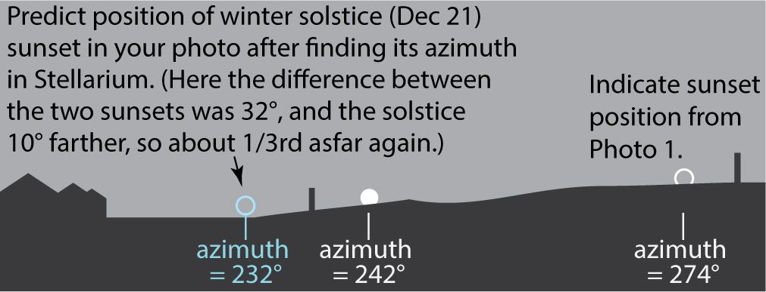
Sunset Project – Final Report
Submit a marked-up picture showing how the Sun moved and how you expect it to shift to 21 Dec.
Compare it to your grid picture to show that the scale is about right.

Slide 14

Tempus fugit…
Sunset project deadline: Tue 19 Apr 2022
Moon extra credit project deadline: Wed 13 Apr 2022

